Slide 1
Beta Meeting
October 2, 2024

Slide 2
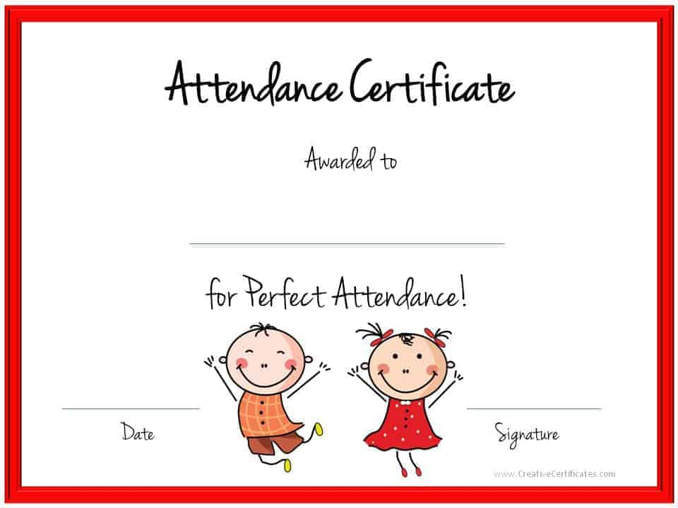
Good morning!
Open Remind and fill out the Microsoft form to take attendance
This Photo by Unknown Author is licensed under CC BY-SA

Slide 3

October is Breast
Cancer
Awareness Month
Wear PINK on Tuesday,
October 8 and earn 1
Hour!

Slide 4

Ends on 10/23
Pick up on 11/8

Slide 5
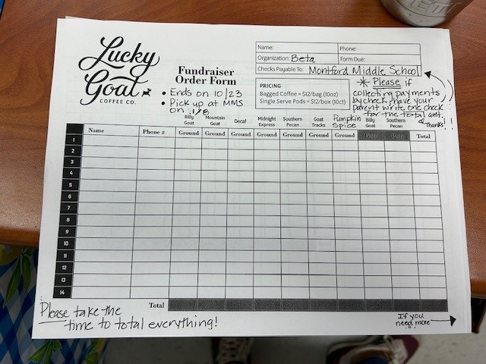
Sell and collect $
Ask everyone, family, friends,
Teachers.
Collect money as you go.
Have people Venmo your parents,
Write a check to your parents, give
Your parents cash
THEN!! Have
Your parents write
One check for the total to MMS.

